Slide 1
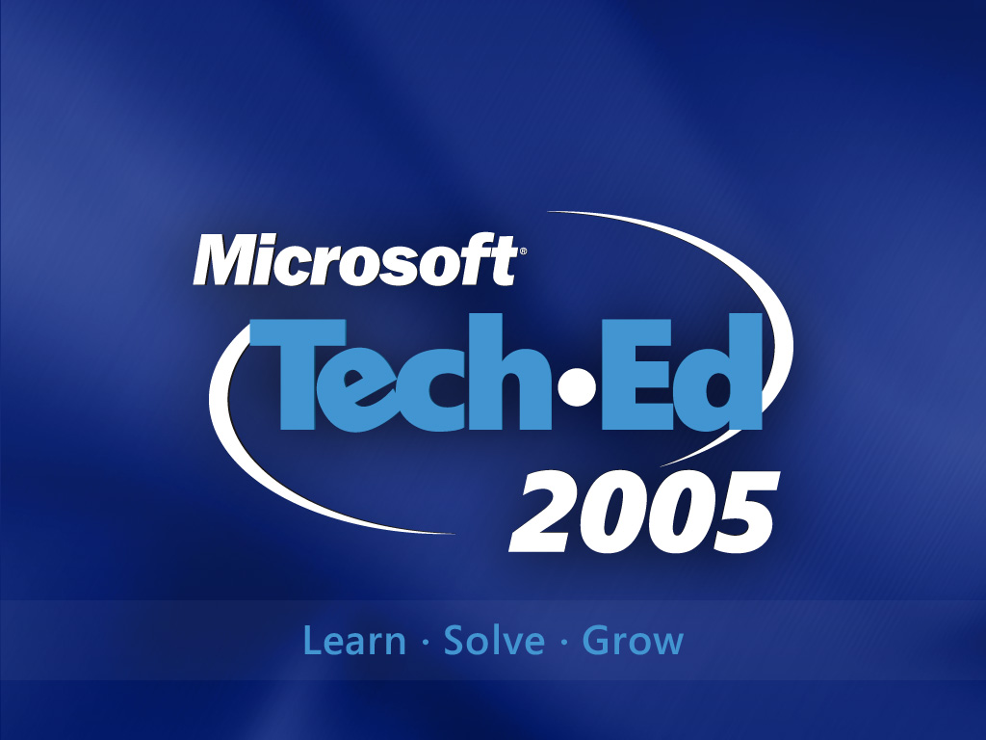

Slide 2

Security for Developers
Threat Modeling and the
Security Development Lifecycle
Steven Borg & Richard Hundhausen
Accentient, Inc

Slide 3

Agenda
Costs of Lax Security
Common Threats
Secure Coding Design Principles
Threat Modeling
Wrap Up
Notes:
In this session you will learn the fundamentals of building secure software. You will learn the basics of threat modeling and see some common coding defects that can expose your systems to risk. And of course you will learn how to mitigate the risks so you can ship secure software.
At the end there is also a short look at some good practices specifically for writing secure .NET code.

Slide 4
Cost of Security Threats
$ 0.9 Million
Sabotage
$ 0.9 Million
System penetration
$ 1 Million
Web site defacement
$ 2.7 Million
Misuse of public Web applications
Telecom fraud
$ 4 Million
$ 4.3 Million
Unauthorized access
$ 6.7 Million
Laptop theft
Financial fraud
$ 7.7 Million
Abuse of wireless networks
$ 10.2 Million
$ 10.6 Million
Insider abuse of Net access
Theft of proprietary information
$ 11.5 Million
Denial of service
$ 26.1 Million
Viruses
$ 55.1 Million

Slide 5
Why Security?
2002 Computer Crime and Security Survey
Percentages of companies who participated in the survey
Reported security breaches in the last 12 months
90%
Acknowledged financial losses as a result
80%
Identified Internet connection as frequent source of attacks
74%
Reported intrusions to authorities
34%
i
http://www.gocsi.com/press/20020407.html
Notes:
This survey was jointly conducted by the Computer Security Institute and the San Francisco branch of the FBI
Companies are loathe to acknowledge computer security breaches, so good statistics are hard to come by
44% of respondents who acknowledged financial losses (223 companies) were willing to quantify those losses. The total was more than $445M
Theft of proprietary information and financial fraud accounted for more than half of the reported financial losses

Slide 6
How Does This Happen?
Common Software Vulnerabilities
Percentages of apps that have "serious design flaws" in the indicated areas
Session management
79%
Parameter manipulation
73%
Access control
64%
Cryptographic algorithms
61%
Handling of sensitive data
41%
Administrative controls
36%
Input validation
32%
Notes:
From private research compiled by @stake, a leading computer security firm
Input validation number is surprisingly low; attacks that exploit input vulnerabilities (e.g., SQL injection and cross-site scripting) are very common

Slide 7
Your Dilemma
Principle #1: The defender must defend all points; the attacker can choose the weakest point.
Principle #2: The defender can defend only against known attacks; the attacker can probe for unknown vulnerabilities.
Principle #3: The defender must be constantly vigilant; the attacker can strike at will.
Principle #4: The defender must play by the rules; the attacker can play dirty.

Slide 8
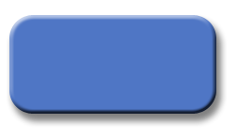
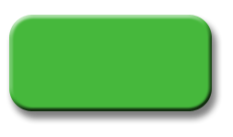
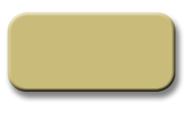
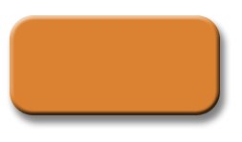
Trustworthy Computing
Security
Resilient to attack
Protects confidentiality, integrity, availability and data
Privacy
Individuals control personal data
Products and online services adhere to fair information principles
Availability
Reliability
Dependable
Available when needed
Performs at expected levels
Business Integrity
Vendors provide quality products
Product support is appropriate

Slide 9
Security
SD³ + Communications
Secure
by Design
Writing Secure Code
Publishing of book by same name
Designing Secure Products
Secure
by Default
Reduce attack surface area
Unused features off by default
Principle of least privilege
Secure in Deployment
Patch management and installation
Protect, detect, defend, recover, manage
Process: How to’s, architecture guides
Communications
Clear security commitment
Full member of the security community
Microsoft Security Response Center
Notes:
<footer>© 2005 Microsoft Corporation. All rights reserved.
This presentation is for informational purposes only. Microsoft makes no warranties, express or implied, in this summary.

Slide 10
Call to Action
Secure software requires knowledgeable and dedicated IT personnel
  Software isn't secure if the network is not
  Administration is the bedrock of security
Secure software also requires knowledgeable and dedicated developers
  Proper administration is meaningless if the code you write isn't secure
  Most developers today don't know they're writing insecure code
Notes:
There are two components to a secure Web application: an administrative component and a programmatic component
Administrative component includes keeping IIS up-to-date with service packs and security updates, hardening routers, making sure firewalls are properly configured, etc.
The programmatic component involves writing secure code, which is what today's Web Security track is all about
SECURE SOFTWARE IS THE PRODUCT OF THOUGHTFUL AND DELIBERATE DESIGN!

Slide 11
Agenda
Costs of Lax Security
Common Threats
Secure Coding Design Principles
Threat Modeling
Wrap Up
Notes:
In this session you will learn the fundamentals of building secure software. You will learn the basics of threat modeling and see some common coding defects that can expose your systems to risk. And of course you will learn how to mitigate the risks so you can ship secure software.
At the end there is also a short look at some good practices specifically for writing secure .NET code.

Slide 12
Types of Threats
Network
Host
Application
Threats against
the network
Spoofed packets, etc.
Buffer overflows, illicit paths, etc.
Threats against the host
SQL injection, XSS, input tampering, etc.
Threats against the application
Notes:
There are three basic threat types: threats against the network, threats against the host (the Web server), and threats against the application. Defenses for threats against the network and threats against the host are primarily administrative. The defense for threats against the application is writing secure code. Imparting the skills and knowledge needed to write secure code is the reason for today's sessions

Slide 13
Network Threats
Threat | Examples
Information gathering | Port scanning
 | Trace routing to detect network topologies
 | Using broadcast requests to enumerate subnet hosts
Eavesdropping | Using packet sniffers to steal passwords
Denial of service (DoS) | SYN floods
 | ICMP echo request floods
 | Malformed packets
Spoofing | Packets with spoofed source addresses
Notes:
Port scanning is a BIG DEAL because ports left open in firewalls expose the servers behind that firewall; for example, failure to block TCP port 1433 and UDP port 1434 at the firewall can enable attackers to connect to SQL Server remotely and, combined with a buffer overflow vulnerability in SQL Server, was the enabling factor behind the SQL Slammer worm in 2003
Eavesdropping means using packet sniffers to pull packets off the wire. Eavesdropping on wired networks requires the attacker to have physical access to the network. Eavesdropping on wireless networks requires nothing more than a wireless sniffer. That's why it's advisable to use Wired Equivalent Privacy (WEP) to encrypt wireless traffic
DoS attacks that rely on malformed packets typically target vulnerabilities in TCP/IP stacks (e.g., ICMP buffer overflows or "pings of death")
SYN floods work by bombarding the target with SYN packets requesting a TCP connection, and then ignoring the SYN/ACK packets that the target responds with. This leaves the target in limbo waiting for a response from the attacker, and can overwhelm targets with soft TCP/IP stacks. Contrary to popular belief, most DoS attacks are NOT accomplished by bruteforce
Packets with spoofed source addresses can be used to work around IP restrictions placed on database servers
Tools for exploiting vulnerabilities in TCP/IP stacks and spoofing source addresses are numerous in the UNIX world

Slide 14


Defending the Network
Harden firewalls
Stay current with patches and updates
Block unused ports and protocols
Use filtering to reject illicit requests
Harden routers and switches
Stay current with patches and updates
Use ingress/egress filtering to reject spoofed packets
Screen ICMP traffic from the internal network
Screen directed broadcast requests from the internal network
Reject trace routing requests
Encrypt sensitive communications
Notes:
Among other things, staying current with patches and updates helps harden the network against attacks that exploit vulnerabilities in TCP/IP stacks
"Block unused ports and protocols" may sound obvious, but the thousands of systems infected by the SQL Slammer and MS Blaster worms proves that many companies have porous firewalls (although in truth, most networks affected by these worms became infected when employees plugged infected laptop computers into the company network behind the firewall)
Firewall filtering works at several levels: packet filtering, application filtering, etc.
An example of ingress/egress filtering is rejecting external packets with internal source addresses
Screening ICMP traffic and directed broadcast requests makes it harder for attackers to enumerate hosts on the subnet
It's also a good idea to secure administrative interfaces on network hardware. Examples include changing default passwords (which are sometimes exploited by attackers), using strong passwords (i.e., passwords that are resistant to dictionary attacks), and disabling admin interfaces on Internet-facing ports
The numbers in superscript refer to items in the Additional Resources section at the end of this slide deck

Slide 15
Host Threats
Threat | Examples
Arbitrary code execution | Buffer overflows in ISAPI DLLs (e.g., MS01-033)
 | Directory traversal attacks (MS00-078)
File disclosure | Malformed HTR requests (MS01-031)
 | Virtualized UNC share vulnerability (MS00-019)
Denial of service (DoS) | Malformed SMTP requests (MS02-012)
 | Malformed WebDAV requests (MS01-016)
 | Malformed URLs (MS01-012)
 | Brute-force file uploads
Unauthorized access | Resources with insufficiently restrictive ACLs
 | Spoofing with stolen login credentials
Exploitation of open ports and protocols | Using NetBIOS and SMB to enumerate hosts
 | Connecting remotely to SQL Server
Notes:
Buffer overflows are bad news because they enable an attacker to inject malicious code and run it on your Web server
Buffer overflow vulnerabilities in ISAPI DLLs on unpatched versions of IIS are the source of numerous security holes. For example, the buffer overflow vulnerability in Index Server (IDQ.dll) described in MS01-033 was the enabling factor behind the Code Red worm in 2001
The directory traversal vulnerability described in MS00-078 led to the defacement of some prominent Web sites in 2001: HP, Intel, Compaq, NY Times
Directory traversal attacks are particularly nasty because they can be used to run Cmd.exe and other system tools
The malformed HTR request bug documented in MS01-031 resulted from a parsing error in ISM.dll. It allows attackers to see file fragments by appending +.htr to the file name. Unpatched IIS 5 servers are vulnerable to this type of attack
Several of the DoS attacks listed here cause IIS to shut down

Slide 16
Defending the Host
Stay current with service packs and updates
Harden IIS with IISLockdown and URLScan
Harden the Web server's TCP/IP stack
Run ASP.NET using principle of least privilege
ACL resources to prevent unauthorized access
Disable unused shares and services
Move Web root to drive other than C:
Notes:
Staying current with service packs and updates is absolutely essential; NO EXCEPTIONS!
IISLockdown is a PASSIVE tool (i.e., run it once) that performs the following actions:
- Disables FTP, SMTP, and NNTP
- Removes key script mappings such as .idq, .htr, and .printer
- Removes IISSamples, IISHelp, Scripts, and other virtual directories
- ACLs system tools and Web content directories to limit access
- Disables WebDAV
- Installs URLScan
IISLockdown isn't needed with IIS 6 because IIS 6 comes with most services and options disabled
URLScan is an ACTIVE tool (i.e., runs all the time) that performs the following actions:
- Logs failed requests
- Limits request sizes to mitigate DoS attacks
- Masks content headers revealing IIS type and version number
- Blocks requests with potentially injurious characters (e.g., dots in path names)
- Canonicalizes and verifies path names to thwart directory traversal attacks
- Disables specified verbs (e.g., "DEBUG")
Hardening the server's TCP/IP stack makes the server less vulnerable to SYN floods and other attacks that exploit vulnerabilities in TCP/IP stacks
"Run ASP.NET using principle of least privilege" means DON'T RUN IT AS SYSTEM! It can also mean running ASP.NET with partial trust. Partial trust is addressed in the supplementary slides at the end of this deck
"ACL resources to prevent unauthorized access" means using NTFS permissions to restrict access to ASP.NET directories and system directories. IISLockdown does some of this for you. The reference cited above lists the minimum NTFS permissions required on ASP.NET directories such as an app's virtual root and the Temporary ASP.NET Files directory. In addition to ACLing these directories with minimal permissions, it's a good idea to ACL the System32 directory so that only admins have full control
Disabling unused shares and services reduces the server's attack surface area. For example, disabling the SMTP service prevents attackers from using malformed SMTP packets to bring down a Web server. Removing unnecessary shares reduces the chance that an attacker can find an insufficiently ACLed share to use as an entry point. It also provides a safeguard against the virtualized UNC share vulnerability documented in MS00-019
Moving the Web root to a drive other than C: is an effective way to foil directory traversal attacks. To date, there is no known exploit that enables an attacker to traverse drives

Slide 17

Defending The Host
Disable unused shares and services
Delete nonessential shares and restrict access to others
Disable nonessential services and protocols (e.g., SMB and NetBIOS)
Remove or secure Remote Data Services (RDS)
Harden user accounts
Disable the Guest account
Use strong passwords on all accounts
Rename the administrator account
Disallow null sessions (anonymous logons)
Restrict remote logons to only those who need it
Be aggressive about logging and auditing
Log failed logon attempts
Log failed actions anywhere in the system
Secure IIS log files with NTFS permissions
Audit access to Metabase.bin
Notes:
<footer>© 2005 Microsoft Corporation. All rights reserved.
This presentation is for informational purposes only. Microsoft makes no warranties, express or implied, in this summary.

Slide 18
Application Threats
Threat | Examples
SQL injection | Including a DROP TABLE command in text typed into an input field
Cross-site scripting | Using malicious client-side script to steal cookies
Hidden-field tampering | Maliciously changing the value of a hidden field
Eavesdropping | Using a packet sniffer to steal passwords and cookies from traffic on unencrypted connections
Session hijacking | Using a stolen session ID cookie to access someone else's session state
Identity spoofing | Using a stolen forms authentication cookie to pose as another user
Information disclosure | Allowing client to see a stack trace when an unhandled exception occurs

Slide 19
Defending the Application
Never trust user input (validate!)
Access databases securely
Avoid vulnerabilities in forms authentication
Secure ASP.NET session state
Store secrets securely
Anticipate errors and handle them appropriately
Notes:
Filtering malicious input is the first line of defense against SQL injection and cross-site scripting attacks
Many ASP.NET apps do NOT access databases securely. For example, they store plaintext connection strings containing user names and passwords in Web.config
Forms authentication is a great feature of ASP.NET, but used improperly, it can be a source of vulnerabilities
"Secrets" means connection strings, passwords, decryption keys, and other sensitive information that could be damaging if leaked

Slide 20
Agenda
Costs of Lax Security
Common Threats
Secure Coding Design Principles
Threat Modeling
Wrap Up
Notes:
In this session you will learn the fundamentals of building secure software. You will learn the basics of threat modeling and see some common coding defects that can expose your systems to risk. And of course you will learn how to mitigate the risks so you can ship secure software.
At the end there is also a short look at some good practices specifically for writing secure .NET code.

Slide 21
Understand The Threats
Need to understand threats to build secure applications
Modeling finds different flaws than code reviews and testing
  Design flaws vs. implementation flaws
Modeling finds flaws that might otherwise be found by attackers
Notes:
<footer>© 2005 Microsoft Corporation. All rights reserved.
This presentation is for informational purposes only. Microsoft makes no warranties, express or implied, in this summary.
Threat modeling is a way to document the potential vulnerabilities in a system. In the process you categorize and rank threats so they can be properly mitigated.
To build secure applications you need to understand the potential threats. For example, you cannot simply use SSL as a catch-all security solution for Web sites. While SSL will protect your Web apps from some kinds of threats, a site can be equally vulnerable to others, such as SQL injection attacks, over http and https.
Threat modeling will help you identify security design flaws that might not have been considered otherwise. Code reviewers and testers tend to find implementation bugs while threat modeling tends to find design flaws.
The extra time spent on this activity will help you find flaws before shipping your products, saving you the time, money, embarrassment, and bad press that comes from a security vulnerability found by attackers.
The threat modeling process is actually quite straightforward.

Slide 22
Designing Secure Code
Defense in Depth
Secure by Design
  Security features != Secure features
Do Not Depend on Security Through Obscurity
Least Privilege
Secure by Default
Fail to a Secure Mode
Learn from Past Mistakes
Notes:
The first thing you need to do on the path toward more secure software is establish a set of principles to guide your design and development.
As a developer, you are always on the defensive against possible attacks on your software. To minimize the possibility of a successful attack you need to maximize your defenses. Defend yourself in depth. In other words, use multiple layers of defense so that a compromise in one part of your system does not compromise the entire system. As a general rule you should write your code under the assumption that every other layer of security has been breached and take the necessary steps to protect the segment or component you are working on. For example, do not assume that user input was validated by another component. A future version of your software might allow your component to be called in a way that bypasses all validation checkpoints, leaving you exposed to potential buffer overrun, SQL injection, cross-site scripting, or other types of attacks
Your systems need to be secure by design. You should intentionally design with security in mind from the onset. You cannot add security as an after-thought. And simply adding some security features such as SSL or IPSec does not make your software solutions implicitly secure. As you will see in the rest of this session, you need to know what your threats are and how to mitigate them.
One of the biggest misconceptions is that obscurity will protect you. If someone on your team says something like “No one would ever do that” or “Why would anyone try that?”, they are suggesting that obscurity is adequate defense. Do not misunderstand: obscurity is a very valuable defense against attacks.

Slide 23
Agenda
Costs of Lax Security
Common Threats
Secure Coding Design Principles
Threat Modeling
Wrap Up
Notes:
In this session you will learn the fundamentals of building secure software. You will learn the basics of threat modeling and see some common coding defects that can expose your systems to risk. And of course you will learn how to mitigate the risks so you can ship secure software.
At the end there is also a short look at some good practices specifically for writing secure .NET code.

Slide 24
Threat Modeling Process
Decompose Application
  DFD, UML, etc.
Build Threat Tree
  Identify threats by type
Categorize Threats Using STRIDE
  Spoofing identity
  Tampering with data
  Repudiation
  Information disclosure
  Denial of service
  Elevation of privilege
Notes:
<footer>© 2005 Microsoft Corporation. All rights reserved.
This presentation is for informational purposes only. Microsoft makes no warranties, express or implied, in this summary.
The starting point is a decomposition of your system that allows you to identify the components, or assets, and the data that flows between them. You can use data flow diagrams or UML or some other approach – whatever works for you to identify the components of your application and the data that flows between them. Note that you only need to drill down enough to understand the components of the application, not the full detailed design.
The components of your system are potential threat targets. They are the assets that would be threatened if a vulnerability exists that could be exploited in an attack against your system.
With your system components identified, you can start building threat trees to identify the potential threats against your system. As you will see momentarily, threats can be comprised of sub-threats and conditions that must be in place for the threat to exist.
For each component in your application model, you need to evaluate whether it is susceptible to any of the six types of threats : spoofing, tampering, repudiation, information disclosure, denial of service, or elevation of privilege. If a type of threat is applicable to a component, you add the threat to your threat tree and assign the appropriate STRIDE categories.
In case you do not know what repudiation is, it refers to denying that something happened. In the case of a software system, it usually means that you cannot prove that an action or transaction took place or was legitimate.

Slide 25
Threat Modeling Process
Rank Threats / Calculate Risk
DREAD
  Damage Potential
  Reproducibility
  Exploitability
  Affected users
  Discoverability
Damage Potential x Likelihood of Occurrence
Notes:
<footer>© 2005 Microsoft Corporation. All rights reserved.
This presentation is for informational purposes only. Microsoft makes no warranties, express or implied, in this summary.
Once a threat is identified it needs to be ranked so you know how bad it really is. The essence here is “how bad is it if this happens and how easy is it to make it happen.” Ranking threats is about calculating risk so that you can deal with higher risk threats first.
One approach you can use is DREAD. You assign a 1 to 10 rating in five areas:
- Damage potential, or the extent of actual damage possible if an attack happened
- Reproducibility, or how easy it is to get a potential attack to work
- Exploitability, or how much effort, expertise, or resources are needed to mount an attack
- Affected users, or how many people would be affected by a successful attack
- Discoverability, or the likelihood that a threat will be discovered
You average the five ratings to get your overall DREAD rating. Higher ratings mean more serious threats. If you are consistent in how you rate threats then you can set a threshold for mitigating threats. For example, you may decide after some threat analysis that only threats with a DREAD rating above 4 will be submitted as bugs to be fixed.
Thinking back to the design principles of defense in depth and not relying on obscurity, you might want to assume that all threats will be discovered and always rate Discoverability as 10 so that the other ratings decide the seriousness of a threat.
Another approach for calculating risk is to rate the damage potential and the likelihood of the threat becoming reality from 1 to 10. Multiply the two ratings together to get a risk rating for each threat from 1 to 100.
It does not really matter how you choose to rank threats so long as you pick a technique and are consistent. Deal with the highest risk threats first and continue until all risk above your threshold has been mitigated.
Now let’s take a look at a sample threat tree.

Slide 26
Threat Modeling
Structured approach to identifying, quantifying, and addressing threats
Essential part of development process
  Just like specing and designing
  Just like coding and testing
One technique presented here
There are others (e.g., OCTAVE)
Notes:
The threat modeling technique presented here is widely used within Microsoft

Slide 27
The Threat Modeling Process
1
Identify assets
2
Document architecture
3
Decompose application
4
Identify threats
5
Document threats
6
Rate threats
Notes:
Identify assets: What is it you want to protect?
Document architecture: Diagram the application, paying particular attention to subsystems, trust boundaries, and data flow
Decompose application: Create a security profile to help identify vulnerabilities
Identify threats: Think like an attacker: How can I break this app? How can I exploit its vulnerabilities?
Document threats: Document the threats using a threat template
Rate threats: Which threats have the potential for doing the most harm?

Slide 28
Identifying Assets
1
What is it that you want to protect?
  Private data (e.g., customer list)
  Proprietary data (e.g., intellectual property)
  Potentially injurious data (e.g., credit card numbers, decryption keys)
These also count as "assets"
  Integrity of back-end databases
  Integrity of the Web pages (no defacement)
  Integrity of other machines on the network
  Availability of the application

Slide 29
Documenting Architecture
2
Define what the app does and how it's used
  Users view pages with catalog items
  Users perform searches for catalog items
  Users add items to shopping carts
  Users check out
Diagram the application
  Show subsystems
  Show data flow
  List assets

Slide 30

Example
Asset #1
Asset #2
Asset #3
Web Server
Database Server
Firewall
IIS
ASP.NET
Login
Bob
Alice
Main
Bill
State
Asset #4
Asset #5
Asset #6
Notes:
Asset #1: public pages (anonymous access allowed)
Asset #2: private pages (viewers require authentication)
Asset #3: Login database (user names and passwords)
Asset #4: Decryption keys
Asset #5: ASP.NET session state database
Asset #6: Main database

Slide 31
Decomposing the App
3
Refine the architecture diagram
  Show authentication mechanisms
  Show authorization mechanisms
  Show technologies (e.g., DPAPI)
  Diagram trust boundaries
  Identify entry points
Begin to think like an attacker
  Where are my vulnerabilities?
  What am I going to do about them?

Slide 32
Example
Forms Authentication
URL Authorization
Web Server
Database Server
Trust
Firewall
Bob
IIS
ASP.NET
Login
Alice
Main
Bill
State
DPAPI
Windows Authentication
Notes:
In this example, forms authentication and URL authorization will be used to authenticate users and define access rules
In this example, the application will use Windows authentication to authenticate against the databases. Windows authentication is one of two forms of authentication supported by SQL Server and is discussed in session 3
In this example, the Windows Data Protection API (DPAPI) will be used to protect the decryption keys. The DPAPI is covered in session 3
The trust boundary encompasses both ASP.NET and the database server because the database server trusts ASP.NET to authenticate the caller

Slide 33
Identifying Threats
4
Method #1: Threat lists
  Start with laundry list of possible threats
  Identify the threats that apply to your app
Method #2: STRIDE
  Categorized list of threat types
  Identify threats by type/category
Optionally draw threat trees
  Root nodes represent attacker's goals
  Trees help identify threat conditions
Notes:
A good way to structure thinking about threat identfication is to think of the big three threat categories: threats against the network, threats against the host, and threats against the application

Slide 34
STRIDE
S
Spoofing
Can an attacker gain access using a false identity?
T
Tampering
Can an attacker modify data as it flows through the application?
R
Repudiation
If an attacker denies an exploit, can you prove him or her wrong?
I
Information disclosure
Can an attacker gain access to private or potentially injurious data?
D
Denial of service
Can an attacker crash or reduce the availiability of the system?
E
Elevation of privilege
Can an attacker assume the identity of a privileged user?

Slide 35
Threat Trees
Theft of
Auth Cookies
Obtain auth cookie to spoof identity
OR
AND
AND
Unencrypted
Connection
Eavesdropping
Cross-Site
Scripting
XSS
Vulnerability
Cookies travel over unencrypted HTTP
Attacker uses sniffer to monitor HTTP traffic
Attacker possesses means and knowledge
Application is vulnerable to XSS attacks
Notes:
This is a simple threat tree. In real life, threat trees are numerous and sometimes much more complex

Slide 36
Documenting Threats
5
Document threats using a template
Theft of Auth Cookies by Eavesdropping on Connection
Threat target | Connections between browsers and Web server
Risk
Attack techniques | Attacker uses sniffer to monitor traffic
Countermeasures | Use SSL/TLS to encrypt traffic
Theft of Auth Cookies via Cross-Site Scripting
Threat target | Vulnerable application code
Risk
Attack techniques | Attacker sends e-mail with malicious link to users
Countermeasures | Validate input; HTML-encode output
Notes:
Countermeasures are discussed in session 3; countermeasures are included here simply for completeness

Slide 37
Rating Threats
6
Simple model
DREAD model
  Greater granularization of threat potential
  Rates (prioritizes) each threat on scale of 1-15
  Developed and widely used by Microsoft
Risk = Probability * Damage Potential
1-10 Scale
1 = Least probable
10 = Most probable
1-10 Scale
1 = Least damage
10 = Most damage
Notes:
Simple model does not directly take into account factors such as whether the attack requires a timing window (e.g., the fact that a stolen authentication cookie is valid for a finite period of time)

Slide 38
DREAD
D
Damage potential
What are the consequences of a successful exploit?
R
Reproducibility
Would an exploit work every time or only under certain circumstances?
E
Exploitability
How skilled must an attacker be to exploit the vulnerability?
A
Affected users
How many users would be affected by a successful exploit?
D
Discoverability
How likely is it that an attacker will know the vulnerability exists?

Slide 39
DREAD, Cont.
 | High (3) | Medium (2) | Low (1)
Damage potential | Attacker can retrieve extremely sensitive data and corrupt or destroy data | Attacker can retrieve sensitive data but do little else | Attacker can only retrieve data that has little or no potential for harm
Reproduc-ability | Works every time; does not require a timing window | Timing-dependent; works only within a time window | Rarely works
Exploitabilty | Bart Simpson could do it | Attacker must be somewhat knowledgeable and skilled | Attacker must be VERY knowledgeable and skilled
Affected users | Most or all users | Some users | Few if any users
Discover-abilty | Attacker can easily discover vulnerability | Attacker might discover the vulnerability | Attacker will have to dig to discover the vulnerability
Notes:
In DREAD modeling, each threat is assigned a rating from 1 to 3 in each of five categories. The higher the number, the greater the threat

Slide 40
Example
Threat | D | R | E | A | D | Sum
Auth cookie theft (eavesdropping) | 3 | 2 | 3 | 2 | 3 | 13
Auth cookie theft (XSS) | 3 | 2 | 2 | 2 | 3 | 12
Potential for damage is high
(spoofed identities, etc.)
Cookie can be stolen any time, but is only useful until expired
Anybody can run a packet sniffer; XSS attacks require moderate skill
Prioritized
Risks
All users could be affected, but in reality most won't click malicious links
Easy to discover: just type a <script> block into a field
Notes:
Plug these risk ratings back into the threat list and you have a concise list of threats that you can prioritize based on risk

Slide 41
Sample Threat Tree
1.2.1
Parse
Request
STRIDE
Threat (Goal)
STRIDE
STRIDE
Threat (Goal)
Threat (Goal)
Threat
Threat
Threat
DREAD
KEY
Threat
Condition
Subthreat
Sub threat
Condition
Condition
DREAD
Condition
Notes:
<footer>© 2005 Microsoft Corporation. All rights reserved.
This presentation is for informational purposes only. Microsoft makes no warranties, express or implied, in this summary.
In this example, the Parse Request process is potentially vulnerable to three high-level threats – an identity spoofing threat, a data tampering threat, and a repudiation threat. These threats are labeled as goals because they are the types of high-level tasks that an attacker would normally be trying to accomplish such as crash a server, hijack an online shopping cart, view someone else’s payroll data, or execute some arbitrary code.
Many threats are actually comprised of sub-threats and conditions that must be present for an attacker to successfully turn a high-level threat into an exploit. Solid lines connect to unmitigated sub-threats. Dashed lines connect to mitigated sub-threats. If two sub-threats or conditions must occur together, they are connected with an arc to represent the AND condition.
In this example, the middle threat, a data tampering threat, can be exploited in three different ways which is why you see three branches with solid lines. The leftmost sub-threat requires a condition to be true or a sub-threat to be exploited. That sub-threat requires two conditions to both be present, thus the arc representing the AND condition. If one of those conditions is guaranteed to never occur, the sub-threat is mitigated because it is only present if both conditions are present.
In this example, STRIDE categories have only been applied to the threat goals. You can also use STRIDE to categorize sub-threats, such as when a sub-threat is actually a different type of threat than the threat goal. For example, an information disclosure sub-threat leads to an identity spoofing threat if an attacker can obtain user credentials.

Slide 42
Pruning Threat Trees
Threat (Goal)
Subthreat
Subthreat
Subthreat
Condition
Subthreat
Condition
Condition
Mitigated
Notes:
<footer>© 2005 Microsoft Corporation. All rights reserved.
This presentation is for informational purposes only. Microsoft makes no warranties, express or implied, in this summary.
Threat models are ever-changing documents that you should update as your design evolves and threats are mitigated. This can help you choose which sub-threats or conditions to tackle since mitigating a single required sub-threat or condition can effectively neutralize a complex higher level threat if there are AND conditions in the tree.
If you look at the tree shown here, you can see that a sub-condition has been mitigated, which effectively mitigates an entire branch of the threat tree because of the AND conditions. The result is that there are now only two options for achieving the threat goal rather than three.

Slide 43
Ongoing Threat Modeling
Threat Modeling is a Design Activity
Start Early
Update Model Regularly
  New features
  New threats
  New ways of attacking systems
Notes:
<footer>© 2005 Microsoft Corporation. All rights reserved.
This presentation is for informational purposes only. Microsoft makes no warranties, express or implied, in this summary.
Threat modeling is an ongoing design activity that should start early. A thorough threat analysis can reveal design flaws early on when it is least costly to make changes. As features are added or removed you need to update the corresponding parts of your threat model. And threat analysis continues for the life of your software products because threats change as attackers discover new ways of attacking systems.
I obviously cannot tell you about undiscovered ways of attacking systems, but I can tell you about some common ways of attacking systems that exist today.

Slide 44
Microsoft Threat Modeling Tool
Allows users to create threat model documents
Organizes relevant data points
  Entry points
  Assets
  Trust levels
  Data Flow Diagrams
  Threats
  Threat Trees
  Other Vulnerabilities
Supports XML, HTML and MHT
Notes:
<footer>© 2005 Microsoft Corporation. All rights reserved.
This presentation is for informational purposes only. Microsoft makes no warranties, express or implied, in this summary.
Threat modeling is an ongoing design activity that should start early. A thorough threat analysis can reveal design flaws early on when it is least costly to make changes. As features are added or removed you need to update the corresponding parts of your threat model. And threat analysis continues for the life of your software products because threats change as attackers discover new ways of attacking systems.
I obviously cannot tell you about undiscovered ways of attacking systems, but I can tell you about some common ways of attacking systems that exist today.

Slide 45
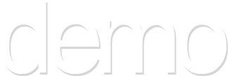
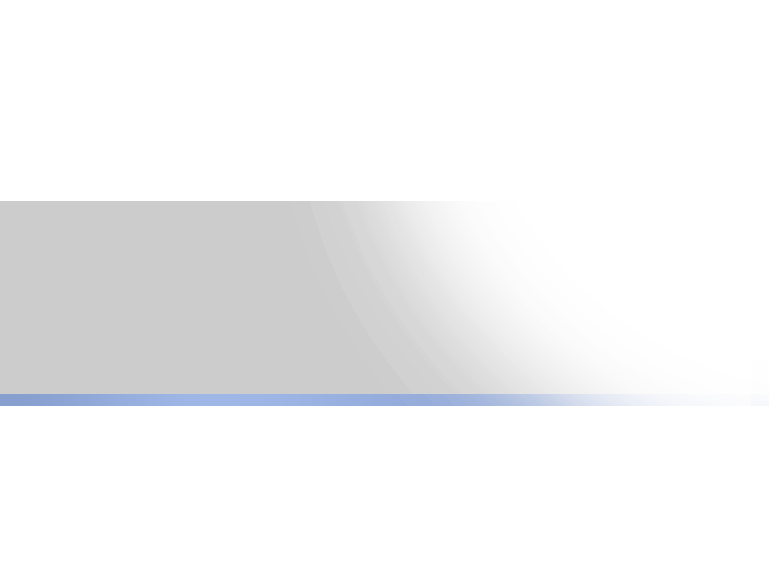
Microsoft Threat Modeling Tool
Notes:
<footer>© 2005 Microsoft Corporation. All rights reserved.
This presentation is for informational purposes only. Microsoft makes no warranties, express or implied, in this summary.

Slide 46
Agenda
Costs of Lax Security
Common Threats
Secure Coding Design Principles
Threat Modeling
Wrap Up
Notes:
In this session you will learn the fundamentals of building secure software. You will learn the basics of threat modeling and see some common coding defects that can expose your systems to risk. And of course you will learn how to mitigate the risks so you can ship secure software.
At the end there is also a short look at some good practices specifically for writing secure .NET code.

Slide 47
Common Defects: Trusting User Input
Do Not Trust User Input
Validate, Validate, Validate
Look for correct data, reject all else
“All input is evil, until proven otherwise”
Michael Howard
Microsoft Corporation
Notes:
<footer>© 2005 Microsoft Corporation. All rights reserved.
This presentation is for informational purposes only. Microsoft makes no warranties, express or implied, in this summary.
Many types of attacks, including the ones I am about to show you, can be boiled down to unexpected or malformed user input. Think about it – buffer overruns, SQL injection attacks, and cross-site scripting vulnerabilities are all caused by bad user input.
Do not trust input. Ever. Assume that all input is evil until proven otherwise. Always validate it.
When validating data, do not try to screen for all possible incorrect or invalid input. Rather, check if data is correct according to the rules for your app and reject all other input. So do not look for HTML tags or SQL commands embedded in a credit card number. Credit card numbers only contain numbers – and perhaps spaces if you’ve decided to allow those. Anything else is invalid input and needs to be rejected.
So let’s take a look at what has become the most infamous type of security defect caused by trusting input that is untrustworthy – buffer overruns.

Slide 48
Rant
Do not provide users with security warnings they must accept to get their job done!!!
  Users are way too Pavlovian!

Slide 49
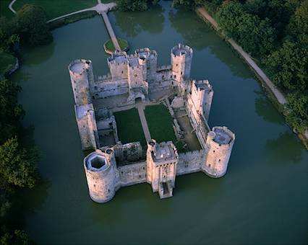


Trust nothing and no one!
“Don’t trust anybody. Even the people you do trust, don’t trust ‘em” – Fahrenheit 9/11
Create trust boundaries
Create input choke points
  Authentication
  Validation
  Authorisation?
Notes:
Canolicalisation not mentioned

Slide 50
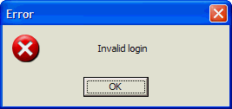
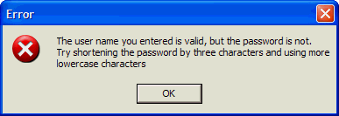
Information Disclosure
Which is the better error message?

Slide 51
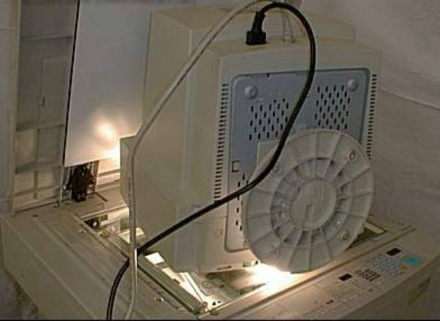
Some Things Can’t Be Avoided

Slide 52
Summary
Defense in Depth
Do Not Trust Input
  Validate for Correctness
Use SQL Parameters Not String Concatenation
HTML Encode & URL Decode Web Output
Compile C++ Code with /GS
Understand Your Threats (Threat Modeling)
Do Not Rely on Obscurity
Notes:
In this session, “Do Not Trust Input” has been a bit of a mantra. It really is the underlying problem of most of the security vulnerabilities you will encounter. Consider all input evil, validate it for correctness, and reject it if it does not pass the validation rules appropriate for your app.
In this session you saw how an attacker can take advantage of SQL statements built using string concatenations. User parameterized SQL statements to prevent data from being inadvertently interpreted as SQL commands.
HTML or URL encode output from your Web pages to neutralize possible cross-site scripting attempts. Of course you should also be screening for correctness on the way in so the output encoding is really a defense in depth measure.
For C++ programs, compile with the /GS option to gain some compiler-added support against stack smashing buffer overruns.
In order to build secure software you need to understand your threats. In this session you saw how threat modeling can be used to help identify the potential threats to your system. Remember that threat models are living documents that you must update as new threats appear because of new features or because attackers have discovered new ways of attacking systems.
Finally, use defense in depth. Write your code with the assumption that all other layers of security have been breached. Secure software is about quality, robust code. Software is not necessarily secure because it uses SSL or encryption. Software is secure because it is meticulously written to behave safely under all circumstances.

Slide 53
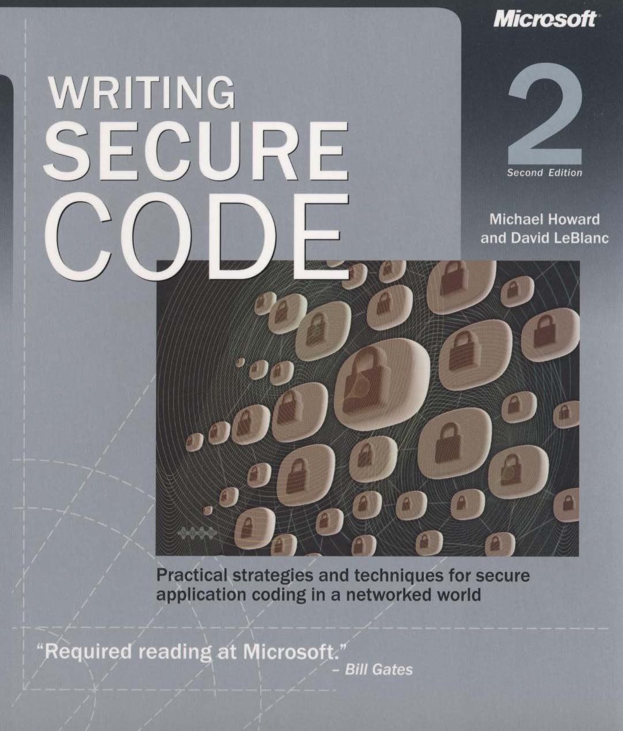
Writing Secure Code
Second Edition
http://www.microsoft.com/MSPress/
books/5957.asp
Notes:
<footer>© 2005 Microsoft Corporation. All rights reserved.
This presentation is for informational purposes only. Microsoft makes no warranties, express or implied, in this summary.
For more information on building secure applications, there is no better resource than the second edition of “Writing Secure Code” by Michael Howard and David Leblanc. Much of this session is based on the guidelines and examples in that book. The second edition was written after many of the Microsoft Security Pushes so it contains valuable examples and lessons learnt from those processes. This book also contains many other real world examples including a significant amount of consideration for managed code and very practical problems like SQL injections and Web-specific threats such as cross-site scripting.
This book should be required reading for every designer, developer, and tester within your programming shop. As Michael Howard would probably say, this is not a book for security geeks. It is a book for any designer, programmer, tester, or tech writer who wants to ship dependable, reliable, high-quality code.

Slide 54

Video Title
Notes:
<footer>© 2005 Microsoft Corporation. All rights reserved.
This presentation is for informational purposes only. Microsoft makes no warranties, express or implied, in this summary.

Slide 55

Partner Title
Name
Title
Group
Notes:
<footer>© 2005 Microsoft Corporation. All rights reserved.
This presentation is for informational purposes only. Microsoft makes no warranties, express or implied, in this summary.

Slide 56

Customer Title
Name
Title
Group
Notes:
<footer>© 2005 Microsoft Corporation. All rights reserved.
This presentation is for informational purposes only. Microsoft makes no warranties, express or implied, in this summary.

Slide 57

Announcement Title
Notes:
<footer>© 2005 Microsoft Corporation. All rights reserved.
This presentation is for informational purposes only. Microsoft makes no warranties, express or implied, in this summary.

Slide 58
Resources
Steve’s Blog: http://blog.accentient.com
Rich’s Blog: http://blog.hundhausen.com
MS Security: http://www.microsoft.com/security
Threat Modeling:
http://msdn.microsoft.com/security/_x000b_securecode/threatmodeling/default.aspx
Security Wiki / Book:
https://www.threatsandcountermeasures.com/wiki/default.aspx

Slide 59

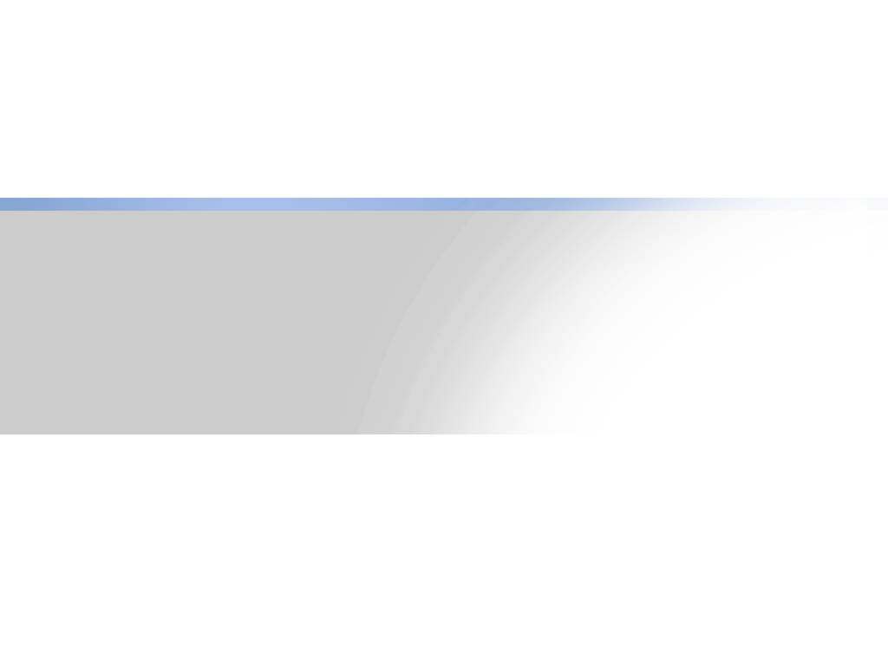
Your Feedback
is Important!
Please Fill Out a Survey for
This Session on CommNet

Slide 60
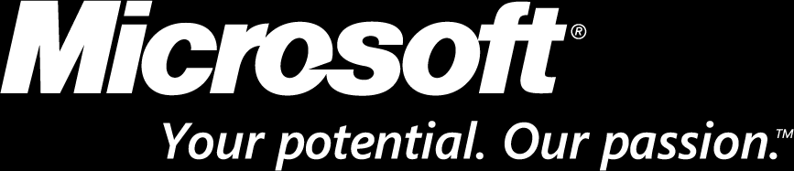
© 2005 Microsoft Corporation. All rights reserved.
This presentation is for informational purposes only. Microsoft makes no warranties, express or implied, in this summary.
Notes:
<footer>© 2005 Microsoft Corporation. All rights reserved.
This presentation is for informational purposes only. Microsoft makes no warranties, express or implied, in this summary.

